Slide 1

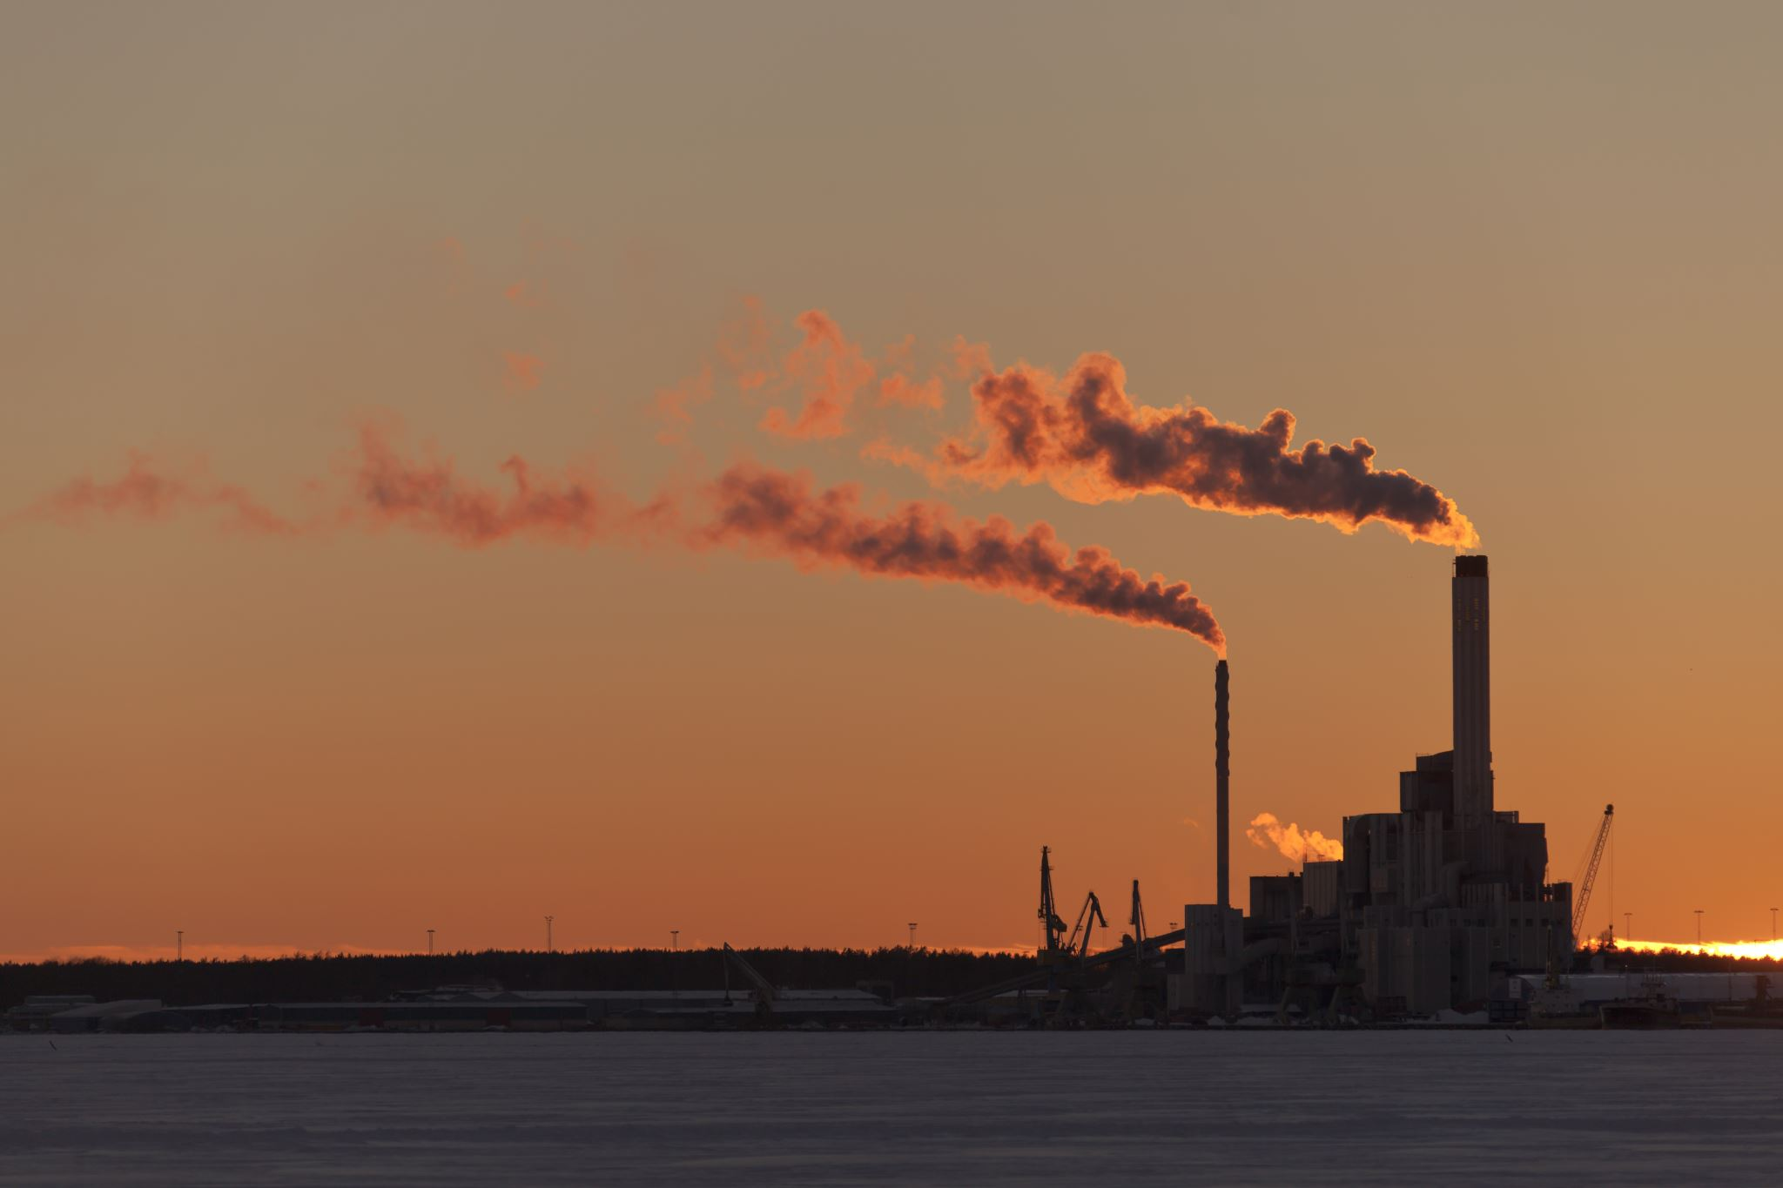

COVAIR- Study Of Air Quality during Covid
Team Members:
Abigail Pearson, Alexander Jutila, Karthik Puttichanda, & Lekshmi Nair
July 23, 2020

Slide 2

Overview
Introduction
Data Sources and Constraints
Results of Analysis
Findings and Summary
Questions
Appendix

Slide 3
Introduction
Study Description:
The purpose of this study is to compare data on Covid-19 cases and air quality in different regions of the planet to find if there is any correlation between the two.
Hypothesis:
The hypothesis of the study is that with the increase in Covid-19 cases from Jan. 1 2020 and July 2020, air quality will improve as areas go into quarantine/ lockdown, due to the reduced industrial and automotive activity.
Null Hypothesis: Across different regions of the planet, there is little difference in the air quality measurements i.e no significant difference in the means between samples from 2019 vs 2020
Hypothesis : H0 : u0 = u1( null hypothesis): there is no change in air quality
H1 : u0 not equal to u1( there is a change in air quality)
If our analysis reveals any significant difference in the samples , then we accept the alternate hypothesis.

Slide 4

Introduction
Questions to be Answered:
Is there a clear impact on air quality during Covid-19 Pandemic compared to 2019 ?
What does that impact look like when broken down into countries across the globe ?
Does the category of cities play a role in the air quality impact in US?
Can the increase in number of Covid-19 cases be used to predict improved air quality and vice versa?
Our Motivation:
In this time of uncertainty and as the entire world take precautions against Covid-19, we wanted to see if it has a positive impact on the environment.

Slide 5
DATA SOURCES and Constraints
Data sources:
AQ data open source:
https://aqicn.org/data-platform/covid19/verify/4bf7812e-385b-43e2-b819-e38ccb3d4c07
COVID data API:
https://documenter.getpostman.com (https://api.covid19api.com/countries)
Other References:
https://www.epa.gov
Limitations:
We are only considering the following parameters to measure AQ : CO, PM2.5 & NO2(μg/m3 )
Meteorological impacts on AQ like temperature and windspeed were not taken into consideration.
We selected countries from different continents to make it a representative sample of the globe
For the COVID cases, the data in the US is available at the city level whereas in other countries the data is collected at the state/province level.

Slide 6
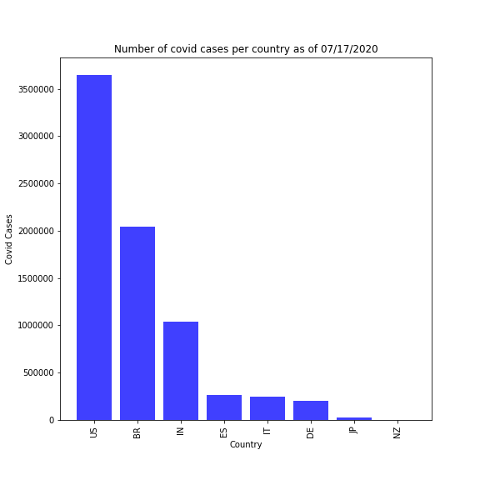
Country level Covid Cases
No | Country | Cases
1 | USA | 3,647,715
2 | BRAZIL | 2,046,328
3 | INDIA | 1,039,084
4 | SPAIN | 260,255
5 | ITALY | 243,967
6 | GERMANY | 202,045
7 | JAPAN | 24,104
8 | NEW ZELAND | 1,550

Slide 7
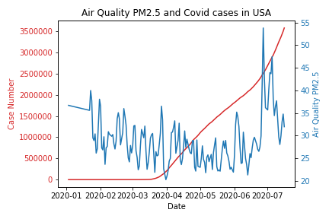
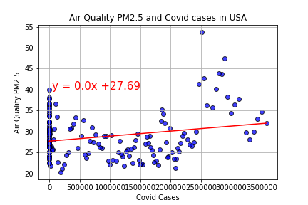
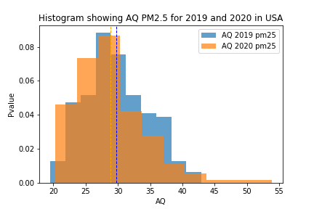
Air Quality Analysis- USA (PM 2.5)
R value: 0.0534
Which indicates the correlation between number of covid cases and Air quality is very weak
P value: 0.105
P value being >0.05 indicates that , we cannot reject the null hypothesis and thus there is no significant difference in AIR Quality between 2019 and 2020 data.

Slide 8
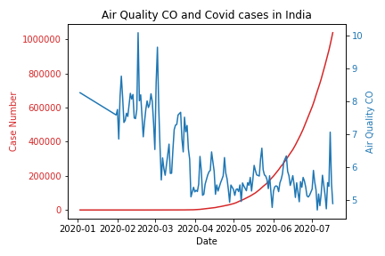
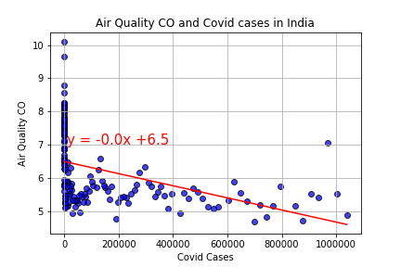
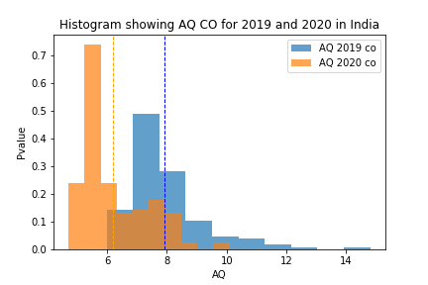
AIR QUALITY ANALYSIS- INDIA (CO)
R value: -0.43
Which indicates there is a weak negative correlation between number of Covid cases and Air quality .
P value: 9.01E-35
P value is very low and <0.05 which indicates that , we can reject the null hypothesis and thus there is a difference in AIR Quality between 2019 and 2020.

Slide 9
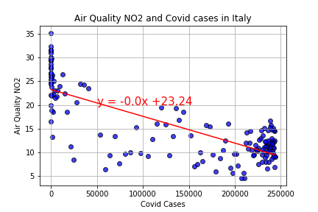
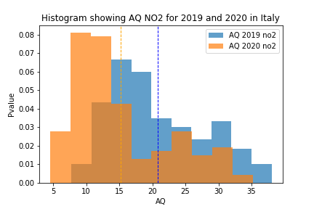
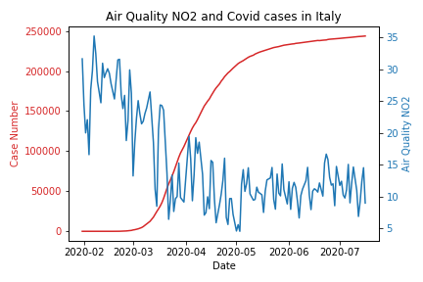
AIR Quality Analysis ITALY (NO2)
R value: -0.77
Which indicates there is a strong negative correlation between number of Covid cases and Air quality .
P value: 4.039E-12
P value is very low and <0.05 which indicates that , we can reject the null hypothesis and thus there is a difference in Air Quality between 2019 and 2020.

Slide 10
US Cities

Slide 11
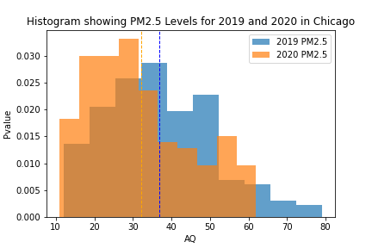
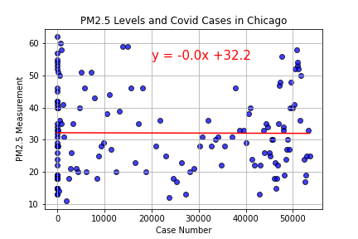
Chicago PM 2.5
P Value = 0.0007
Indicates significant difference in air
quality between 2019 and 2020
R Value = 0.006
Correlation = None or Very Weak

Slide 12
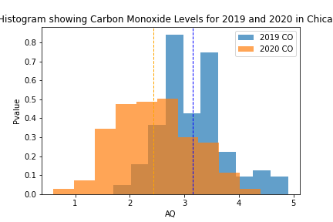
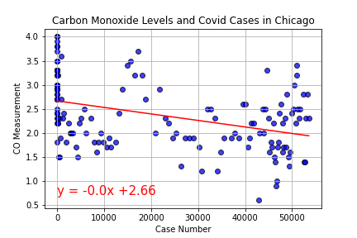
Chicago CO
P Value = 5.68E-23
Indicates significant difference in air
quality between 2019 and 2020
R Value = 0.4
Correlation = Weak

Slide 13
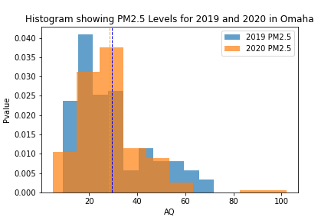
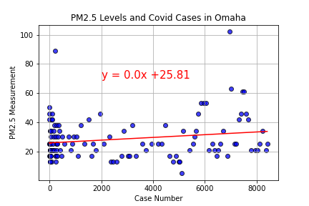
Omaha pm2.5
P Value = 0.4
Indicates no significant difference in air
quality between 2019 and 2020
R Value = 0.18
Correlation = None or Very Weak

Slide 14
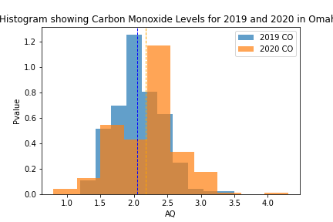
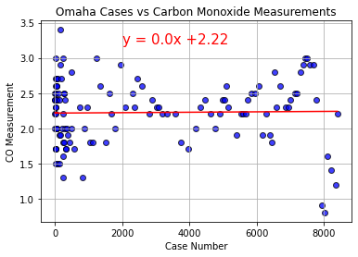
Omaha CO
P Value = 0.004
Indicates significant difference in air
quality between 2019 and 2020
R Value = 0.02
Correlation = None or Very Weak

Slide 15
SUMMARY
AIR QUALITY for COUNTRIES (US, JP, IT, SP, GR, NZ, BR, IN, NZ)
Based on P values,
1) PM25 improvements were observed in JP, IT, NZ, GR, SP, BR & IN
2) CO improvements were observed in IT, SP, BR, IN, NZ &US
3) NO2 improvements were observed in IT, SP, BR, IN, US, GR & JP
CONCLUSIONS:
Shutdowns across the globe had an effect on the Air Quality parameters.
Data indicates that reduced industrial activity and vehicle emissions helped improve air quality parameters.
City data from Boston and Chicago show that during the shut down period( resulting in reduced vehicular emissions and industrial activity) shows an improvement in Air Quality parameters, when compared to 2019.
COVID CASES vs AIR QUALITY for COUNTRIES
Based on correlation values,
1) PM25 – strong to moderate negative correlation observed in IT, SP, BR & IN
2) CO - strong to moderate negative correlation in JP, IT, SP, BR & IN
3) NO2- strong to moderate negative correlation in IT, SP, BR, IN, US, & JP
CONCLUSIONS:
Countries with high COVID cases show a relationship with improved Air Quality parameters
The negative correlation indicates that the rise in Covid cases (X variable) resulted in the reduced air Quality parameters (Y variable).
The US is an outlier among countries as all parts of the country did not completely shutdown thus showing air quality improvements in only certain cities ( Boston, Chicago).

Slide 16





QUESTIONS

Slide 17
APPENDIX – DATA TABLES

Slide 18
JAPAN | PM2.5 | CO | NO2
R 2 Value | 0.0006 | 0.545 | 0.293
Correlation | -0.03 | -0.74 | -0.54
P - value | 2.978 | 0.0759 | 0.00032
US | PM2.5 | CO | NO2
R2 Value | 0.0534 | 0.084 | 0.33
Correlation | 0.23 | 0.29 | -0.58
P -value | 0.105 | 0.0033 | 0.00012
GR | PM2.5 | CO | NO2
R2Value | 0.006 |  | 0.108
Correlation | -0.08 |  | -0.33
P - value | 4.001 |  | 4.915
IT – | PM2.5 | CO | NO2
R2Value | 0.44 | 0.15 | 0.599
Correlation | -0.66 | -0.39 | -0.77
P - value | 0.00016 | 0.00054 | 4.039

Slide 19
IT | PM2.5 | CO | NO2
R2Value | 0.44 | 0.15 | 0.599
Correlation | -0.66 | -0.39 | -0.77
P - value | 0.00016 | 0.00054 | 4.039
NZ | PM2.5 | CO | NO2
R2 Value | 0.109 | 0.0414 | 0.163
Correlation | 0.33 | 0.2 | 0.4
P - value | 1.09 | 0.00015 | 0.796
SP | PM2.5 | CO | NO2
R2 Value | 0.1618 | 0.517 | 0.43
Correlation | -0.4 | -0.72 | -0.66
P - value | 0.000057 | 1.80E-10 | 3.14E-15
B R | PM2.5 | CO | NO2
R2 Value | 0.048 | 0.135 | 0.25
Correlation | 0.22 | 0.37 | 0.5
P - value | 5.69 | 7.6622 | 2.79
B R | PM2.5 | CO | NO2
R2 Value | 0.048 | 0.135 | 0.25
Correlation | 0.22 | 0.37 | 0.5
P - value | 5.69 | 7.6622 | 2.79

Slide 20
AIR QUALITY PARAMETERS- DEFINITIONS
Particulate matter (PM10/2.5)Airborne particulate matter varies widely in its physical and chemical composition, source and particle size. PM10 particles (the fraction of particulates in air of very small size (<10 µm)) and PM2.5 particles (<2.5 µm) are of major current concern, as they are small enough to penetrate deep into the lungs and so potentially pose significant health risks. Larger particles meanwhile, are not readily inhaled, and are removed relatively efficiently from the air by sedimentation. The principal source of airborne PM10 and PM2.5 matter in European cities is road traffic emissions, particularly from diesel vehicles. The limit values are very often exceeded in European cities.
Nitrogen oxides (NOx)NOX is a term used to describe a mixture of nitric oxide (NO) and nitrogen dioxide (NO2). They are inorganic gases formed by combination of oxygen with nitrogen from the air. NO is produced in much greater quantities than NO2, but oxidises to NO2 in the atmosphere. NO2 causes detrimental effects to the bronchial system. Nitrogen dioxide concentrations frequently approach, and sometimes exceed air quality standards in many European cities. NOx is emitted when fuel is being burned e.g. in transport, industrial processes and power generation.
Carbon monoxide (CO)CO is an odourless, tasteless and colourless gas produced by the incomplete burning of materials which contain carbon, including most transport fuels. CO is toxic, acting by reaction with haemoglobin and reducing its capacity for oxygen transport in the blood. Even in busy urban centres, CO concentrations rarely exceed health related standards.

